Slide 1


MODELLING DIFFUSE SUBCELLULAR PROTEIN STRUCTURES AS DYNAMIC SOCIAL NETWORKS
Master’s Thesis
By
Andrew Durden
Under the Direction of:
Shannon Quinn
Frederick Quinn
Tianming Liu
Notes:
-Name Andrew Durden
-Working in the Quinn Research Group since early 2018
-My thesis is: modelling diffuse subcellular protein structures as dynamic social networks

Slide 2
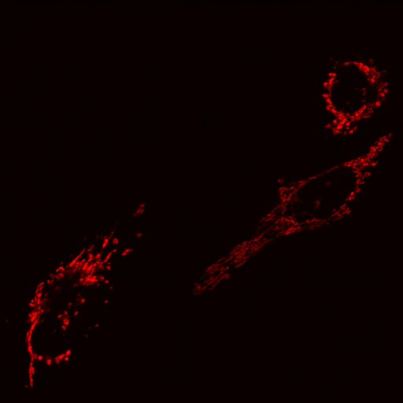
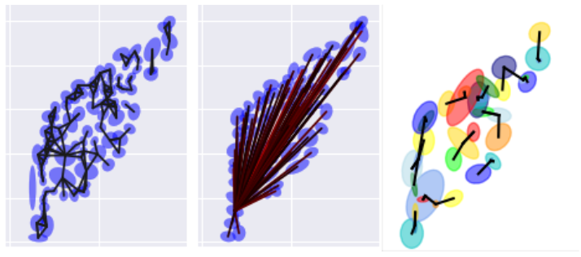
Ornet (Organellar Network)
Fit network models to diffuse organellar structures to study cell behavior
Notes:
-My work is part of a larger project called ornet
Ornet’s goal is to map ornellar structures like mitochondria and actin as social networks
The purpose of the model is to provide a robust and open source method of quantifying these structures.
In my time on the project:
- We have developed a robust seeded segmentation process for the diffuse image data.
We have further applied a fully data driven method for modeling mitochondrial structures as social networks
We have shown how the model can invoke biological insights

Slide 3
Outline
Ornet
Outline
Introduction
Image Analysis Background
Significance and Motivation
Segmentation
Network Engineering
Determining Nodes
Edges and Affinities
Network Analysis
Conclusion/Next Steps for Ornet
Classical Approaches
Deformable contours
Our Segmentation and Extraction Pipeline
Proposed Pipeline
Social Networks and Graph Theory
Notes:
Ok here’s a roadmap
We just discussed ornet
First I want to give bit of background
Image Analysis
Significance of our model
Some graph theory
Finally our proposed pipeline
Then we’ll dive deeper into the segmentation process
Discuss Traditional approaches
Talk about our use of the deformable contour
Then our method for segmenting
With our cells extracted we’ll discuss our network model
First how we fit nodes to the protein
Then our edges and affinities
Then we’ll discuss some of the analyses we’ve done of our model
Finally we’ll discuss next steps for ornet
Before we go further into detail, I want to give a quick roadmap for the coming presentation.
I just briefly discussed the Ornet project, what it is and what it aims to do.
Next I want to give more background, first a brief history of flourescense microscopy based image modeling, then a look into the novelty and significance of this particular approach, and before we discuss the pipeline itself I want to get you acquainted with the datset we used.
Then I’ll discuss our segmentation pipeline, beginning with a look at classical approaches in image binarization and their effectiveness on our datset, a quick look at a common deformable contours algorithm, and finally our current pipeline
After segmentation I want to discuss how we developed our social network model, beginning with some graph theoretical background, and moving first into how we determined our nodes then our various formulas for determining their connectedness.
I then want to support the work by showing some early qualitative analysis of our generated networks
Lastly I will discuss the next steps for the Ornet project, both in further model analysis as well as in model augmentations and improvements.

Slide 4
Introduction
Notes:
Like I said before, I want to start with a bit of background of the work.

Slide 5
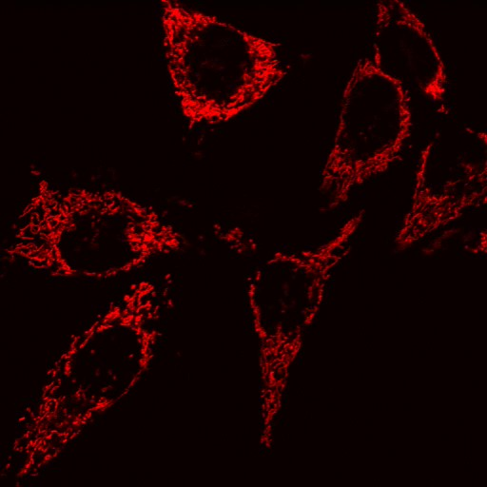
Advancements in Medical Imaging and Modeling
Automated microscopes increase quantity of data
Manual annotation had been the norm
Efforts in automated image analysis exploded
BioImageXD
Icy
Fiji
Deep Learning has become the cutting edge (U-net)
Notes:
Medical Image Data has grown
Automated Microscopes
Higher quality cameras
Manual annotation
40,000 videos of roundworm embryogenesis
Reduce human labor
Increase consistency
Spreading of computervision techniques
Generalized Tools
Deep learning growth
Toolkits like Cuda
Libraries like Keras
Efficient training algorithms
AlexNet 2012
U-net 2015
Over the last few decades there’s been remarkable growth in medical imaging and modeling which has lead to an increase in the scale, specificity, and complexity of our ability to visually monitor biological phenomena. With the growth in quality and quantity of these manual annotation struggled to keep up. That’s not to say manual annotation didn’t scale at all, for instance there’s a set of 40,000 videos of embryogenesis in roundsworms which was fully manually annotated. However, scientist quickly began developing automated annotation and analysis tools to reduce human labor.
This lead to a democratization of computational image analysis through the release of tools such as BioImageXD, Icy, and Fiji. As well as through the publishing of guides of introductory techniques which can be used on many sets of data. Meanwhile the deep learning community gained momentum with advances in hardware and in training techniques allowed for more widespread research into deep learning architecture. This lead to CNNs becoming the recent standard in computer vision, and many offshoots being used on medical image analysis specifically i.e. U-Net

Slide 6
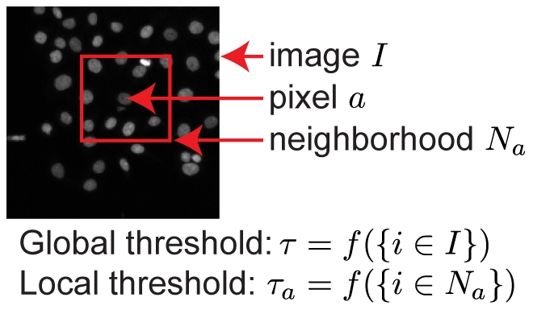
Focus on Solid Bodies
Objects like full cell, nuclei, microorganisms all exhibit solid structure
These solid forms are more commonly used for teaching and for algorithmic research
Image sources:
Top: (Ljosa & Carpenter 2009)
Bottom: ISBI cell tracking competition (Maska et al. 2014) (Ulman et al. 2017)
Notes:
Focus on Solid Bodies
Full cells, nuclei, microorganisms
Clear edge gradients, contiguous structures
More common naturally
Used to teach methods
Used to research new algorithms
Lead to a dearth in generalized open source tools for diffuse protein structures
However, with much of this advancement there has been a clear focus on solid bodies, such as microorganisms, full cell bodies, or organelles like nuclei. These exist as fully contiguous forms with a defined boundary. This focus is a result of them being more common in teaching examples and in datasets used for algorithmic research. What we see here is an image taken from an article focused on the democratization of medical image analysis methods, specifically the section discussing adaptive thresholding. Below are two images taken from the ISBI cell tracking competition datasets. This is one of the larger publicly available corpuses of biological imaging across various mediums and subjects. This dataset is used in many studies of new techniques for segmentation and modeling. A more recent and cutting edge model, the U-net used these datasets as benchmarks in the publication of their model.
These solid objects are simpler to model, and the techniques used for them often don’t translate to more diffuse objects like those we hope to model.

Slide 7
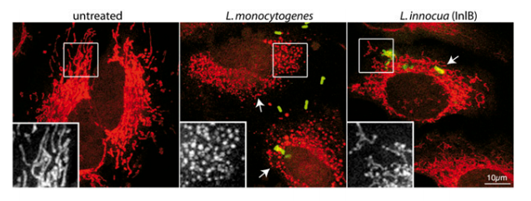
Significance
Improve our ability to describe dynamic cell morphology
Further understand effects of various stimuli on mitochondrial behavior
Mitochondrial misbehavior have been shown to be:
Causative in neurogenerative diseases
Evidence of bacterial infections
Image source:
(Stavru et al. 2011)
Notes:
Why Model diffuse structures
Improve description of cell morphology
Murphy lab in Carnegie mellon
Further understand Mitochondrial behavior
Mitochondira fission fusion
Neurogenerative desease
Evidence of bacterial infection
Lysteria
Developing a modeling pipeline for these non-solid bodies will allow us to more accurately describe dynamic cell morphology. Recent studies by the Murphy lab at Carnegie Mellon aim to build generative models of cell and nuclear shape. A heavy focus in a recent publication is a static spatial model of mitochondria to parameterize their localization. We hope to expand upon this by not only spatially modeling these organelles but also by evolving our model overtime to capture the dynamic behavior of the mitochondria.
Mitochondrial proteins themselves are constantly undergoing repeated fission and fusion. Imbalances in these actions create various morphologies.
Certain misbehaviors of mitochondria are linked to neurogenerative diseases. Morphologies have also been shown to be evident of certain bacterial infections. A dynamic model like we propose would allow these unique morphologies to be detected and quantified for more detailed study.

Slide 8
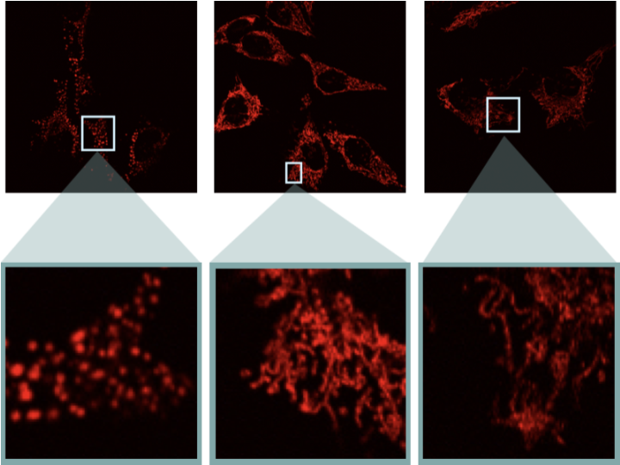
Our Dataset
HeLa cells transfected with DsRed2-Mito-7
Images were captured every ten seconds for the length of the video.
Three morphologies
Fragmented (LLO)
Control/Wild Type
Hyperfusion (Mdivi1)
Notes:
Put together by infectious diseases
HELA cells
DsRed2-Mito-7
Every 10 seconds
20,00 frames
Morphologies
LLO
Wild
Mdivi
We aim to condition our network analysis on these morphologies
Our partners in the VetMed department created a library of videos taken of HeLa cells using DsRed2-Mito-7 as the fluorescence agent. This labels mitochondria with red emission spectra. The videos contain over 20,000 frames each, with each frame being captured every ten seconds over the course of the video.
In our dataset we capture three distinct morphologies. In the center is the wild type mitochondria, which is our control morphology in which fission and fusion are happening in a normal balanced way. On the left is an example of a fragmented protein structure which is induced by introducing listeriolysin O (LLO) which is a pore-forming toxin found in Listeria. On the right is an example of our hyperfused data. This stringy structure is a result of the addition of mitochondria division inhibitor-1 of Mdivi1. These three subsets of our ata serve as a bases for conditioning the analysis of our network models.

Slide 9
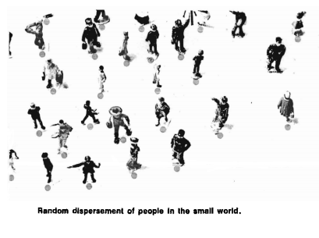
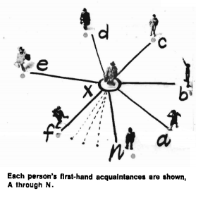
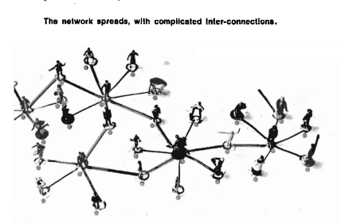
Social Networks
Started in sociology
Became more popularized:
6 degrees of separation
Kevin Bacon Number
Have been applied to various fields:
Ecology
Internet Topology
Microbiology
Image source:
(Milgram 1967)
Notes:
Old
Early studies by milgram
6 degrees of separation
Bacon and Erdos
Academic studies
Ecology predator prey food webs
Internet topology
Sites and hyperlinks
Servers and network latency
Microbiology
Microbial metabolic networks
- At it’s root its all graph theory
Social networks have been studied for decades, initially as an area of sociological work to study people. Individuals were linked together through some sort of bond or affinity. Many individuals linking together creates a crisscross mesh of connections. In the early days on social network analysis, these models were fit to study kinship structures, social mobility, academic citations, criminal or deviant activity, and other areas of social interactivity
public notions of direct connectedness between people gave rise to the adage that all people have at most 6 degrees of separation, stemming from an early study which showed an average of 5.2 degrees of separation amongst the subjects (Milgram 1967), or to more recent fun games like the Kevin Bacon number, an actor’s degree of separation from Kevin Bacon in a social network model connecting actors to those who have appeared in the same film.
In ecology studies have approached food webs with social network framework in order to study how various species consume each other. In their network a species is connected to another in the network if the former consumes the latter.
Models have been fit in many ways to web pages for studying the topology of the Internet. One study fits a model to static web pages connecting a page to another if the prior page links to the latter page. This model is used to further design better web crawling strategies, study content creation, analyze web algorithms like PageRank which use link information, and to predict the emergence of new topological phenomena on the web graph
In microbiology social network models are fit to many biological structures to model their interactions. One study builds a social network to model metabolic networks which models substrates as the individuals in the network connected to each other by links representing metabolic reactions. The analysis establishes new characteristics of the structure of metabolic networks and quantify the metabolic network of organisms in all three domains of life: eukaryote, bacterium, and archaea

Slide 10
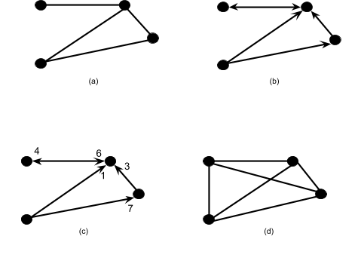
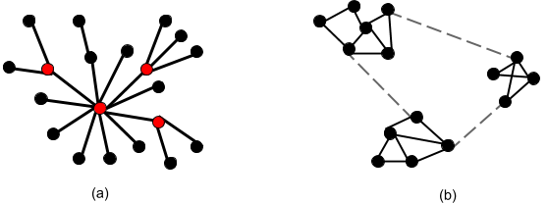
Graph Theory
Set of Nodes
Connected by edges
Directed or Undirected
Weighted or Unweighted
Differing structures
Random Network
Scale Free Networks
community structures
Graph Theory Based Metrics
Clustering Coefficient
Network Diameter
Notes:
Graphs are
Nodes
Edges
Directed or undirected (predator prey)
Weighted or unweighted (latency in routing)
Structures
Random
Scale free
Communities
Metrics
Clustering Coefficient
Network Diameter
Graphs are models as nodes with connected edges
An edge can be directed or undirected, weighted or unweighted (point to graphs)
Furthermore the underlying structure of a graph can fall into two distinct categories. Random Networks and Scale Free Networks
Random are like the top where the number of connections are fairly consistent throughout
Scale-free networks often contain and build off of hubs. A new node is most likely to connect to a hub node when joining the network. This is the structure more found in nature.
Another characteristic in graphs is the community structure in which several nodes are highly connected, with these clusters having weaker connection between them.
This can further be hierarchical with communities of communities forming.
Fields in Academic Publishing,
Family Branches in Kinship,
Functional groupings in metabolic networks
Clustering Coefficients are a measure global or local connectivity
Networks or neighborhoods with higher numbers of connections between nodes have higher clustering coefficients
Depending on how our network is built, this could give insight into the grouping of the mitochondria in our cells both globally or locally
Network Diameter is a measurement of shortest path length between the most distant nodes.
This gives a global metric for the span of our network which could serve in a model with induced sparsity to distinguish between c mitochondrial structure pre and post fragmentation.

Slide 11
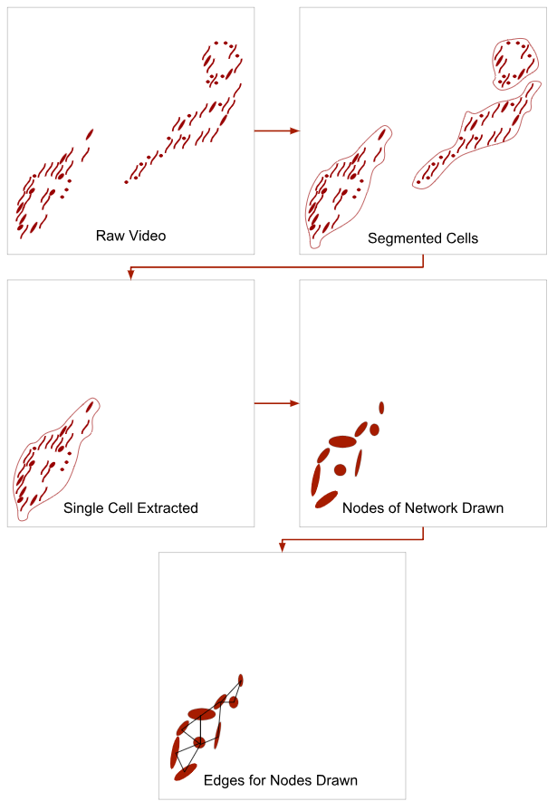
Proposed Pipeline
Segmentation
Extract
Fit Nodes
Determine Affinities/Edges
Network Analysis
Notes:
Our proposed pipeline
Temporally evolves
Before we jump into more details, I want to quickly go over the pipeline as a whole so that future steps can motivate the decisions I made when creating our modeling process.
The first step is to segment each cell. A process that was made difficult due to the diffuse nature of our dataset and the close proximity between the cells. With the segmentation maps derived, we then extract each cell into its own video, which is a trivial process given segmentation masks.
Once each cell is ready to be examined on it’s own we fit nodes to the cell to model the mitochondrial communities.
With nodes fit we apply an affinity function between each node, and create our edges.
At this point the model is ready for network analysis which can take many forms.
This whole pipeline will be fit to a frame such that it informs the frame following, creating a network model which evolves over time to simulate the behavior of the underlying structure.

Slide 12
Segmentation
Ornet
Outline
Introduction
Image Analysis Background
Segmentation
Network Engineering
Determining Nodes
Edges and Affinities
Network Analysis
Conclusion/Next Steps for Ornet
Classical Approach
Deformable contours
Our Segmentation and Extraction Pipeline
Significance and Motivation
Social Networks and Graph Theory
Proposed Pipeline
Notes:
In order to avoid systematic bias in our model generation we have chosen to separately model each cell. This requires segmenting each cell from each video.

Slide 13
Thresholding
The traditional approach
Has two main variants
Global: single value
Adaptive: multivalue
used for binarization of greyscale images
Image source:
(Ljosa & Carpenter 2009)
Notes:
Threshold based segmentation
Binarize the image and post process
Types of thresholds
Global
adaptive
A classic approach to segmentation is to use a thresholding algorithm. There are two commonly distinguished types of thresholds. Global, and Adaptive. These thresholds are used for converting a greyscale image into a binary image where objects are white and the background Is black or vise versa. In a global threshold a single value is used across the image while in Adaptive thresholds different regions or neighborhoods each use different threshold values. Once the image is binarized, various processes can be used like watershed to separate overlapping objects and connected component analysis to label individual objects.
This is the earlier image from an article discussing common opproaches to medical image analysis. Here they show how the threshold value differs when using a local or adaptive threshold

Slide 14
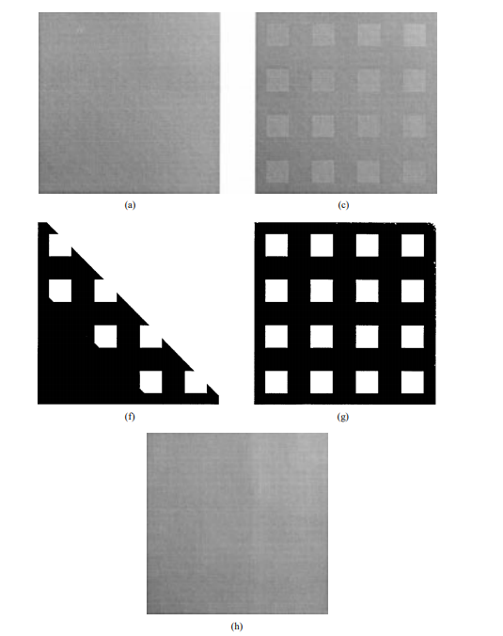
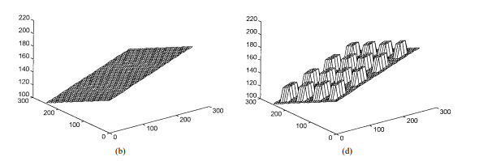
Adaptive Thresholds
Fit multiple thresholds to regions of the image
Allows for better results when lighting or background varies
Examples:
Neighborhood approach
Surface Fitting
Image source:
(Chan et al. 1998)
Notes:
Multivalue
Best in varied conditions
Can apply global to regions
Use neighborhood statics for each pixel
Or fit surfaces like here
Adaptive thresholds fit multiple values to different regions of the image. This is generally used to combat variance in lighting or background intensity. Often an adaptive threshold uses similar formula to global thresholds just over the neighborhood of each pixel. More advanced adaptive thresholds fit polynomial surfaces to the background of the image In order to extract the object regions.
The image here illustrates surface fitting on a varied background. The first image shows a gradient upon which squares with a constant additive intensity are place. We then see the plots of these two images in three dimensions which illustrates how a surface fit to this image can find a varied threshold

Slide 15
Global Thresholding
Uses a single threshold
Works best in uniform images
Variety of methods:
Histogram shape
Pixel value clustering
Manually set values
Image source:
(Chan et al. 1998)
Notes:
Single Value
Best on uniform image (pics)
Can use convex hull on grey level histogram
Search for peaks as zero crossings in the histogram’s gradient
Cluster pixels on their value
Otsu (exhaustive search)
Isodata (1-d clustering inter-means)
Manually set (domain knowledge)
WE mainly used Otsu’s and ISODATA
Global Thresholding uses a single threshold across the entire image. They work well in uniform images with less processing need than adaptive threshold.
Many forms of global thresholds leverage the grey-level histogram of the image sometime searching for concavities or peaks and valleys as heuristics to determine a good thresholding value.
Another common approach is to cluster pixel intensities into two groups, the object and the background. The most common of these is Otsu’s threshold which employs an exhaustive search through the intensity space to minimize variance between the clusters and maximize the scatter between the classes. ISODATA clustering is a similar approach, separating the pixels using an inter-means threshold (a threshold halfway between the means of each group).
Here we see a comparison of otsu and the surface fitting approach on the image from the previous slide. Otsu fails to follow the background gradient giving bad binarization in the two corners.
However since our videos held a constant lighting and background value we tended to use Otsu’s and ISODATA as our thresholding techniques

Slide 16
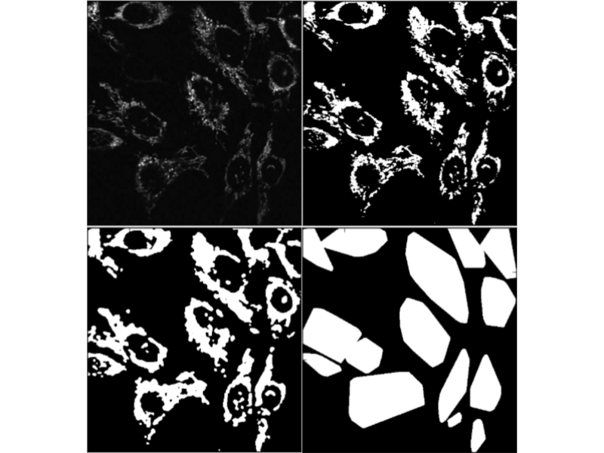
ISODATA results
Process:
Applied global threshold
Dilated and removed small holes
Applied convex hull to each component
Shortcomings:
Separates single cell into multiple mask
Merges adjacent cells into single mask
Notes:
When the image is thresholded
Dilation and closing
Convex Hull
Connected components
Issues
Separated cell into multiple masks
Merges adjacent cells
We then looked to create hand drawn seeds to initialize a deformable contour
When segmenting solid bodies it is common to binarize the image and post process using watershed algorithms to separate overlapping bodies, and to dilate and use a convex hull to create masks of each object.
We followed these common steps, applying an ISODATA threshold followed by dilation and morphological closing to remove small holes. Then applied a convex hull as a first attempt at creating segmentation maps for our cells
However due to the diffuse structure of our imaged proteins this method is unable to provide reliable masks. It often separates a single cell into multiple masks when the protein has gaps, or merges cells together during the dilation when cells are near each other.
Because of these results we decided to prime our segmentation with hand drawn masks on the first frame and leverage the low movement between frames to employ a deformable contour process

Slide 17
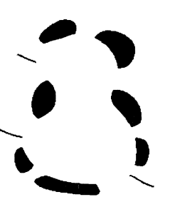
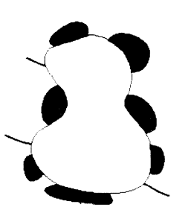
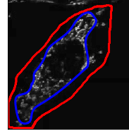
Deformable Contours
Requires initial contours
Manually drawn seeds
Snakes Model
Localize edges using energy-minimization
Iteratively adjusts localization until it reaches energy equilibrium
Can be used to track low motility objects
Image source:
(Kass et al. 1988)
Notes:
-Deforms contour
Snakes
Minimizes the energy iteratively
Aims for smooth curves along edges
Can fit along gaps (illusion)
Can track in low motility
Too restrictive
Lost protein
Too slow
We initially looked to use the Snakes model of deformable contour. Because of it’s independence of edge gradients we felt it could fit around the diffuse portions of our cell border.
The snakes model fits a line uses energy-minimization. It iteratively adjusts this localization until an equilibrium is found. We had hoped that because of the low motion that this could effectively be used to track the contour’s change over time.
However when applied to our cells the models were overly restrictive often disregarding ‘rouge’ portions of protein separated from more contiguous structures. We can see it’s application here with the hand drawn contour in red and the snake’s model convergence in blue.
Furthermore, the snake process was incredibly slow on a standard machine to use on our entire dataset. We then looked to leverage the higher level idea of a deformable contour using simpler underlying approaches.

Slide 18
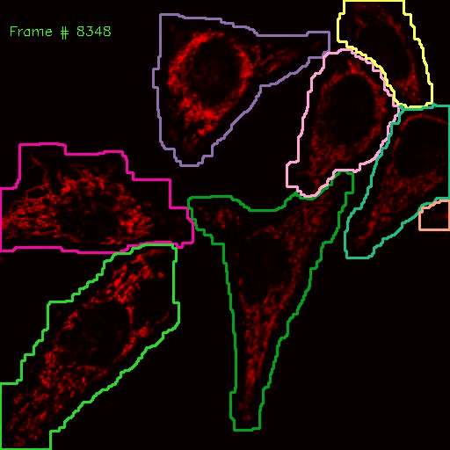
Our Segmentation
Merges thresholding and deformable contours
Uses previous frame as seed
Determines a tight contour within the seed using global threshold
Dilates that tight contour iteratively
Eliminates overlaps during dilation
Notes:
Start with seed
Threshold inside
Too restrictive
Dilate iteratively
Overlaps
Overlap Detection
Too slow
Pair lookup list
Growth in uncontested
Tight in contested
With our final segmentation we aim to merge the simplicity of threshold based segmentation with the tracking of deformable contours. Using a previous frame’s mask or the initial manual masks for frame 0, as seeds the process finds a new set of contours for each cell in the image.
It starts by using a global threshold to create a restrictive threshold within the seed mask. This is to avoid pulling data from neighbor cells into the mask. To compensate for the loss of protein in the restrictive contour a period of iterative dilation is started. During this process the contour is expanded repeatedly while checking for overlaps in each pair of cells. When an overlap is detected, an XOR is used to remove the overlapping area. This allows for flexible contours which are generous in uncontested regions while creating tight boundaries in contested areas.
This pairwise overlap detection slowed down our segmentation process immensely especially in more crowded videos. In order to improve this we leverage the lack of motility in the cells again and created a lookup table of cell pairs which have previously overlapped. The lookup table is populated over the initial twenty frames. And then referenced and updated every 100 frames.
This works well as cell rarely move closer to one another, but in fragmenting they can often create space between them.

Slide 19
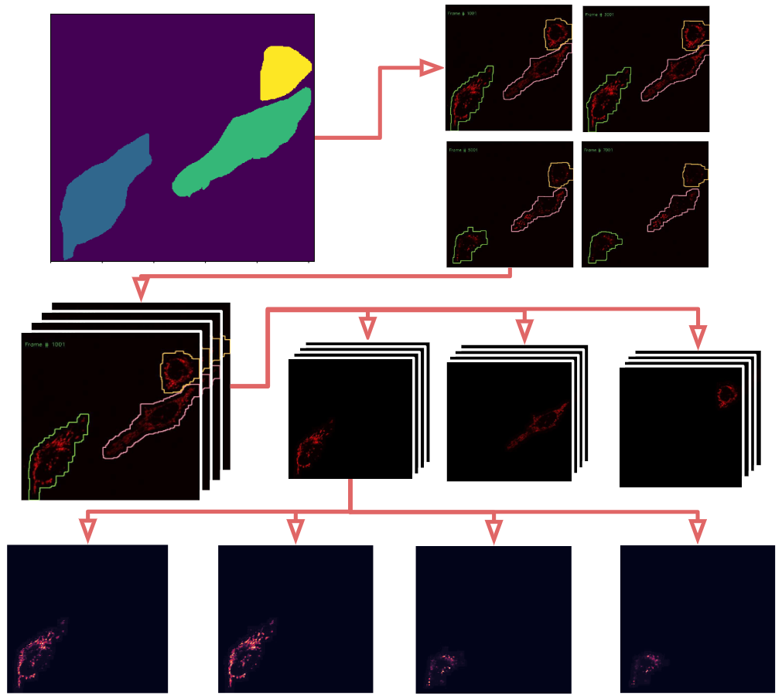
Cell Extraction Pipeline
Notes:
Seed
Segment
Extract
Fit network
Our final Cell Extraction pipeline begins with hand drawn masks for frame zero. Then the segmentation process is run over the video. Each mask is them pulled out into a separate video so a single cell can be analyzed over time.

Slide 20
Network Engineering
Ornet
Outline
Introduction
Image Analysis Background
Segmentation
Network Engineering
Determining Nodes
Edges and Affinities
Network Analysis
Conclusion/Next Steps for Ornet
Classical Approach
Deformable contours
Our Segmentation and Extraction Pipeline
Significance and Motivation
Social Networks and Graph Theory
Proposed Pipeline
Notes:
With the cells extracted we have to look into how to fit a social network model to the protein structure in our images

Slide 21
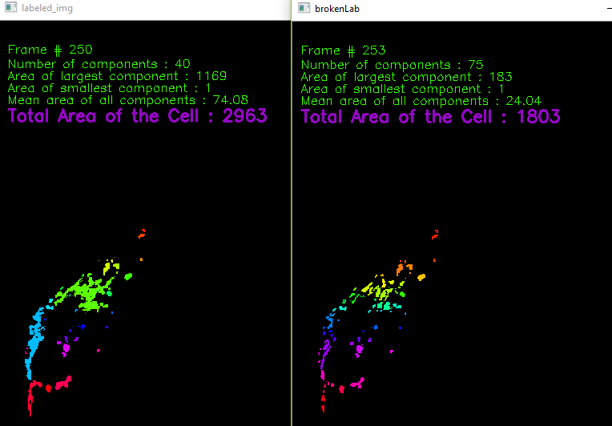
Creating Nodes
Initially used connected component analysis
Pros
Grouped protein together based on vicinity
Low processing time
Cons
Data is lost in thresholding
Relationship between nodes is difficult to discern
Notes:
Connected components
Threshold single cell image
Each connected blob is a node
Awkwardly large nodes
Broke them into smaller
Cons
Data loss
No temporal link
Difficult to relate nodes to each other
An early approach to find nodes in our diffuse protein structure was to find connected components within the structure. Because areas of high intensity imply a high concentration of mitochondria, a connected component approach would split areas of high concentration of mitochondria along boundaries where the concentration is lower.
Initially this resulted in a small number of large communities which we would have then considered nodes in our network model. However, we wanted more homogeneity between the nodes themselves in order to better model the connection between them.
In order to break these larger communities further down we applied a stricter threshold in the areas of the larger than average components in our initial connected component label, this created more boundaries within the larger communities.
We then relabeled the broken-up components. This process created more homogenous nodes which represented more similarly sized communities of mitochondria
The main drawback of the connected components approach was a loss of data in any portion of the protein structure that is considered the boundary between the communities. This data loss is exacerbated by the process which further separates the larger components.
Another issue in the connected components labeling is that the raw pixel intensity data, which represents the density of mitochondria, is lost unless it’s mapped back in from the initial images. Without the raw intensity the only characteristic which can be observed is the size and shape of the communities.
We decided to turn to a new method of determining nodes, using a gaussian mixture.

Slide 22
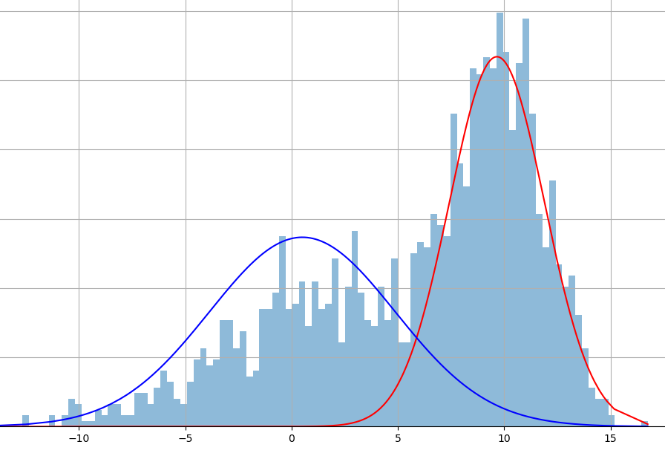
Gaussian Mixture Model
Fits a mixture of gaussians to model data
Follows and expectation-maximization algorithm
Computes each data points probability of belonging to each gaussian
Adjust Gaussian parameters to maximize probabilities
Repeat until convergence
Notes:
Approximate a PDF
EM
Compute probabilities
Perturb parameters
Repeat
Illustration
A gaussian mixture model fits a mixture of gaussian distributions to a set of data points. The model assumes that all of the data points being fit are generated from a mixture of a finite number of Gaussian distributions. For our purposes we are modeling the communities of mitochondria as gaussian distributions, the mixture of which forms the diffuse mitochondrial pattern of the cell. The gaussian mixtures are fit through an expectation-maximization (EM) algorithm. EM is an iterative process which computes a probability for each point belonging to each gaussian component of the mixture model. The gaussian parameters are then tweaks to maximize the likelihood of the data points given the probabilities. When repeated this process will eventually converge to a local optimum
Here we see a bimodal distribution in one dimension being fit by a two component gaussian mixture model
A 2018 study in the Murphy Lab used spherical GMMs to statically model mitochondria for the purpose of localizing the protein.

Slide 23
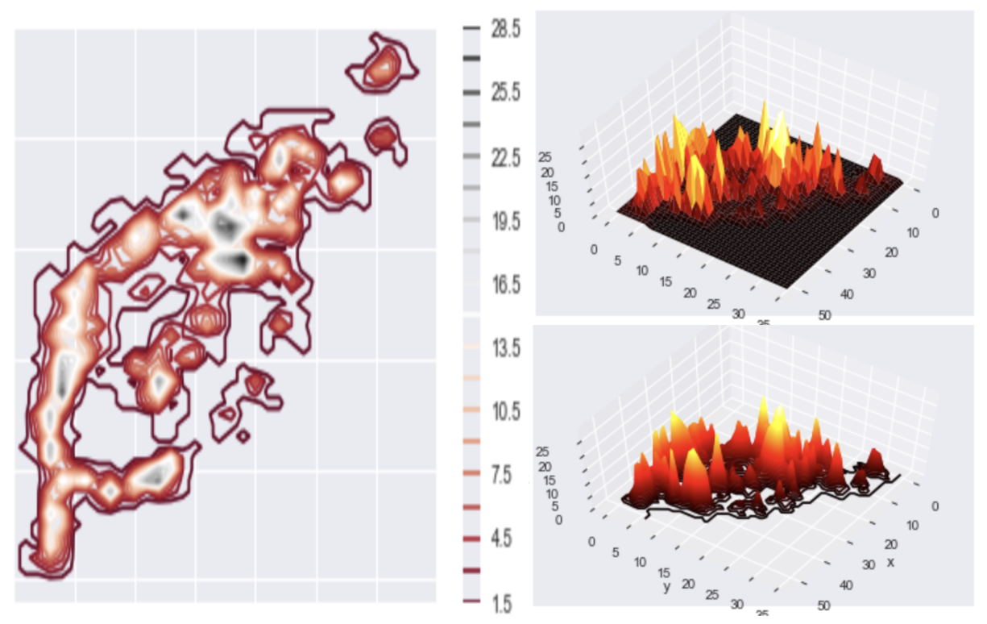
Preprocessing for GMM
First we removed noise with a Gaussian Smoothing Filter
Next we need to view the image as a probability density function
Normalize the intensities to sum to one
Determine initial mixture parameters
Max filter to determine initial means and number of components
Covariance uses the covariance of the pixel neighborhood
Notes:
-Smooth image
Normalize to PDF
Initialize params
Means at local max
Covar based on variance in pixel neighborhood
Here we see the distribution of intensities
The first step is to fit a Gaussian smoothing filter to minimize or eliminate artifacts in the video images. With the image smoothed we normalize the grayscale pixel intensities to sum to one. This converts each frame to a discrete probability distribution which the mixture model will approximate (Fig 12). With these preprocessing efforts done we need to find deterministic seeds for the gaussian parameters for each video. Because each mixture is intended to model a community of mitochondria in the overall pattern, we treat each local maximum in the image as the initial mean points for our gaussian components (Fig 12). Our covariances are initialized as diagonal matrices containing the variance of the mean’s 8 neighbors.

Slide 24
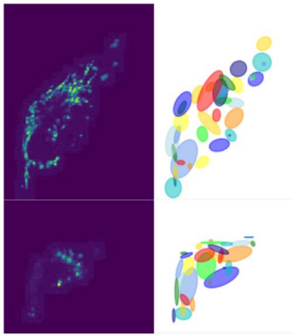
Creating Nodes
Modeled protein with a Gaussian Mixture Model
Pros:
Incorporates all of the data
Gives spatial covariance of the communities
Can use previous frame to initialize
Cons:
Higher processing time
Preprocessing steps require hyperparameters
Notes:
After first frame the previous frame informs the next
It’s much slower
Doesn’t throw away data
Temporally connects nodes
Gives a quantified spatial component
Creates hyperparameters which influence number and size of nodes
These initial parameters seed the GMM to fit to the first frame, and for each following frame, the previous frame’s output parameters initialize the fitting process (Fig 11). The learned GMM components would minimize the disparity between the joint probability density of the GMM, and the original empirical probability density of the image, parameterizing the structure of the mitochondrial pattern. Using the learned components as nodes in the final network allow for the network structure to be learned purely from the mitochondrial topology

Slide 25
Creating Edges
Initially used a radial-basis function with a manual threshold
Uses the Euclidean distance between two nodes
Didn’t take covariance into account when determining Neighborhood
Altered this method by using the covariance the direction of the connection to replace the manual threshold
More data-driven
Still induces sparsity
Accounts for directionality of components
Cons
Was overly dependent on distance
Point wise comparison
Notes:
First try used distance as a radial basis function
Manual threshold
Pros
Fast and simple
Cons
ignores the spacial component
Use Covar to determine threshold
Pros
Fully data driven
Somewhat considers directionality (barely)
Cons
Overly dependent on distance
Fully Point-wise comparison
To connect the nodes with weighted edges, we explored multiple approaches that balanced realistically encapsulating the underlying biology (i.e., did not create strong connections between weakly correlated objects) and computational tractability. Initially, we chose a manual distance threshold and used this as the "neighborhood size" for the radial-basis function, a common connection weighting metric that varies smoothly from 0 (not connected) to 1 (fully connected) and is a function of the Euclidean distance between the two nodes, weighted by the neighborhood size. A second attempt to make this process more data-driven was to replace the manually-crafted neighborhood size with the Gaussian covariance in the direction of the node to be connected (Fig 14, mid). In both cases, to avoid fully-connected graphs and induce some sparsity, we set a hard threshold on the maximum distance between nodes to connect

Slide 26
Creating Edges
Moved towards a probability based metric
The weight of the connection between A and B is the probability of the mean of B in the distribution A.
Accounts for directionality in creating the weights
Created an Asymmetric graph
Only offered pointwise comparison
Notes:
Used a probability based metric
A to B is B in A
Asymmetric, weighted, fully connected
Pros
Accounts for directionality in weights
Still computationally simple
Cons
Still mostly a pointwise comparison
Asymmetric (not a huge deal)
To address these shortcomings with determining network connectivity, we instead evaluated the Gaussian components directly and used that probability as the edge weight. This not only accounted for the anisotropy in the covariance of the Gaussian components, but also captured the asymmetry between components: by decoupling the direct link to Euclidean distance, the connections could instead be weighted by how probable the location of the node under consideration was (Fig 14, right). While this did result in an asymmetric graph matrix, it more accurately reflected the dynamics of the underlying biology, captured the relationships between nodes in a more intuitive metric, and was entirely data driven with no hand-crafted thresholds.
We did however struggle with this newer approach as it still only offered a pointwise comparison between the mean of each node. This meant that nodes could have a weak connection if the probability of the mean point of one is low in the other, despite the nodes’ ‘spread’ having an overlapping region in the outlying region along the principle axis

Slide 27
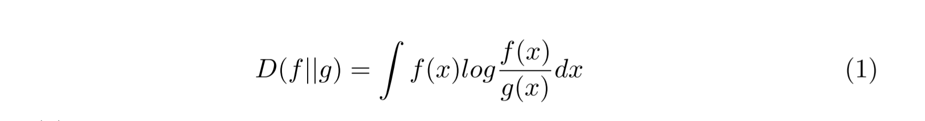
Creating Edges
Applies divergence metrics as affinity
Kullback-Leibler (KL) divergence
Jensen-Shannon (JS) divergence
Takes full gaussian distribution into account
Allows for both asymmetric and symmetric affinities
Notes:
Divergences
Measures the similarity of two empirical distributions
Not pointwise
Kullback-Leibler (KL)
Asymmetric
0 is identical
Trends upwards as they differ
Jensen-Shannon (JS)
Adapts KL
0 is still identical
But Symmetric
No clear biological reason to prefer asymmetry
Symmetry allows for more flexibility in analysis
Spectral Decomposition
To move away from these pointwise metrics and determine a weighted connection that considered the full gaussian distribution which defines each node we began using divergence metrics. The first divergence metric we worked with is the Kullback-Leibler (KL) divergence. KL divergence is also known as relative entropy and is used as a measure of similarity between two probability density functions f(x) and g(x),
The KL divergence is a popular statistical metric due to its properties of selfsimilarity, self-identification, and positivity. As two distribution become more identical, their KL divergence nears zero. However, D(f || g) = 0 only if f = g. We then began to use the KL divergence as the weight of the connection between two nodes, creating a 31 directed network as KL divergence is asymmetric. Many popular social networks have asymmetric connections between users. For example, Twitter and Instagram permit users to follow another without being followed back. Even Facebook, which has a symmetric "friend" connection, has asymmetric underlying weights in terms of how friends interact over the network
Yet, with a cell’s general Brownian behavior, the undirected structure seems more analogous and flexible. In order to create an undirected network, we used a similar divergence method, Jensen-Shannon (JS) divergence. JS divergence is a metric based on KL divergence, with two notable differences. Firstly, JS divergence is always finite, which allows for more well-behaved networks for further analysis. More importantly, JS divergence is a symmetric metric which, when used as weights in our social network, gives us the undirected network structure which we desire to model the mitochondrial proteins
This process serves as a basis by which the networks can be created, with some elements of the graph structure becoming more cemented as we analyze the networks created

Slide 28
Network Analysis
Ornet
Outline
Introduction
Image Analysis Background
Segmentation
Network Engineering
Determining Nodes
Edges and Affinities
Network Analysis
Conclusion/Next Steps for Ornet
Classical Approach
Deformable contours
Our Segmentation and Extraction Pipeline
Significance and Motivation
Social Networks and Graph Theory
Proposed Pipeline
Notes:
As we built our network models we’ve been able to observe systematic difference in the learned model parameters to separate our varying conditions (wild type/ LLO/ mdivi1).

Slide 29
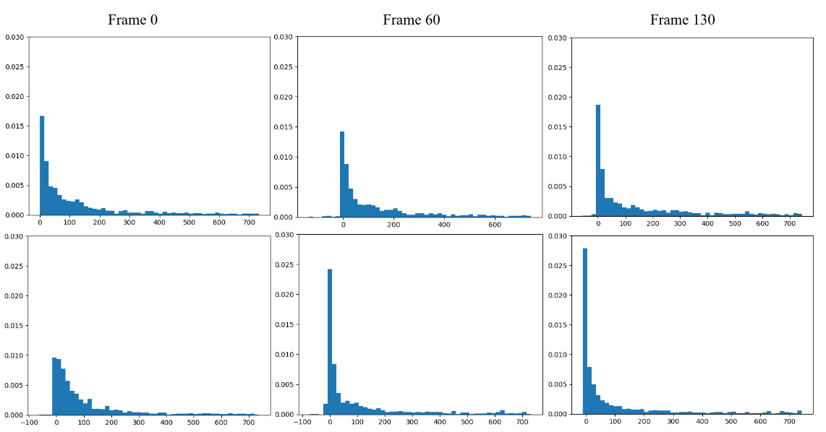
Affinity Distribution
Distribution of affinities over time between Wild type (top) and LLO (bottom)
Using probability based affinities
Negative log of the affinity
Notes:
Using early model iteration
Probability based affinities
Affinity change over time
Neg log(1) ~ 0
Neg log(0) ~ inf
Control (top)
Consistent
LLO (bottom)
Gets more strongly connected
As cell fragments it collapses
Nodes get closer
By virtue of proximity they become more affine
First we viewed the negative log of the probability based affinities in our early network models. Over time the wild-type cells held a consistent affinity distribution as the behavior is constant over the timeframe of the video. However our fragmenting protein affected by LLO shows an increase in affinities over time. While this seems counter to the idea of the mitochondria fragmenting, what happens is the protein both reduces in spatial spread, and condenses into fewer communities. As the number of components is fixed in our network model this condensing of the protien brings nodes closer in proximity increasing their probability based affinities.
. The overall number of connections also increases in thresholded networks, as the cells tend to collapse at the same time as mitochondrial fragmentation, resulting in the same number of GMM components spatially co-locating in a much smaller space, effectively "forcing" connections by virtue of proximity

Slide 30
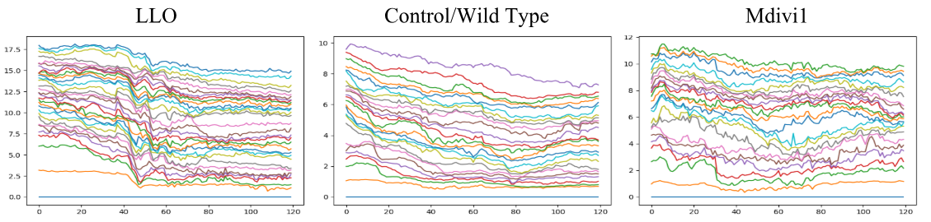
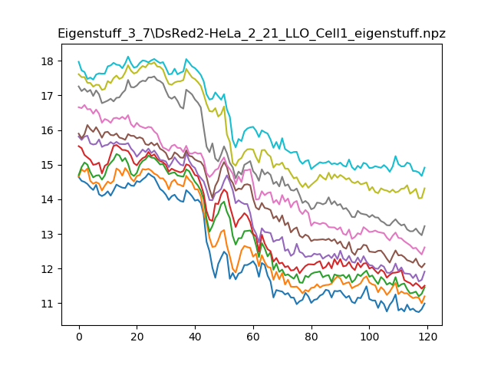
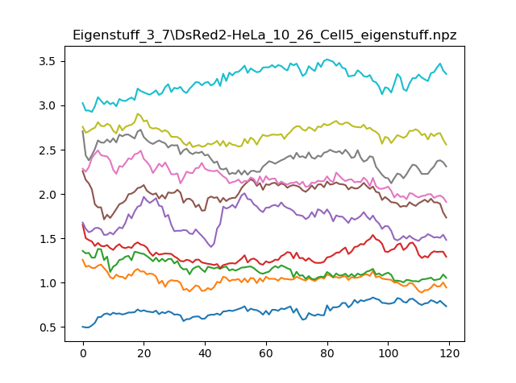
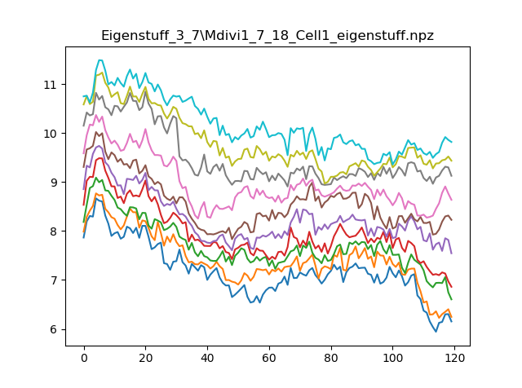
Spectral Decomposition
Apply a heat kernel to convert JS divergence to similarities
Create a graph Laplacian from similarity matrix
Use Spectral Decomposition to factor the Laplacian
Viewed Eigenvalues over time
Notes:
-temporal model of component evolution
Spectral Decomposition
Heat kernel for similarities
Laplacians
Decompose to get Eigenvalues
We plot the change in the 10 most principal Evs over time
Control is fairly steady and well behaved
LLO has a clear period of fragmentation
Mdivi struggles to find an equilibrium
LLO is similar after fragmentation
- These metrics are able to give a fairly clear view into phenotypic evolution of the protiens
The next step, then, was to develop a temporal model of the GMM component evolution in terms of the social network. We did this by creating a series of graph Laplacians and observing how the Laplacians change through spectral decomposition.
Because the most current form of creating weights uses Jensen-Shannon divergence, the graph’s matrix does not hold similarity values, but rather it holds divergence values. In order to correct for this, we apply a heat kernel (3) to transform this affinity matrix into a similarity matrix so that the network will be suited for spectral decomposition.
Once each network’s affinity matrix is converted using the heat kernel, the graph Laplacians for each frame can be found. We then apply an eigensolver to decompose 34 each Laplacian into eigenvectors and eigenvalues. Using this approach, we were able to qualitatively observe differences in the temporal behavior of the cells in each of our varied conditions (control/ wild type, LLO, and mdivi).
We can easily see the fragmentation period in a cell reacting to LLO which exhibits similar temporal behavior to traditional wild type before and after in most of the principle components. The hyperfused mdivi samples have an active turbulent behavior, likely due to the even probability density function that the hyperfused mitochondrial pattern emulates, and the difficulty of fitting a consistent mixture of gaussians to an even probability space. We also see the LLO exhibit a similar behavior in the less principle components after the fragmentation takes place as the GMM struggles to fit the previous number of components to the fragmented cell.

Slide 31
Conclusion/ Next Steps
Ornet
Outline
Introduction
Image Analysis Background
Segmentation
Network Engineering
Determining Nodes
Edges and Affinities
Network Analysis
Conclusion/Next Steps for Ornet
Classical Approach
Deformable contours
Our Segmentation and Extraction Pipeline
Significance and Motivation
Social Networks and Graph Theory
Proposed Pipeline
Notes:
There is still significant room for expansion in analysis and improvement in the model for the Ornet project to pursue.

Slide 32
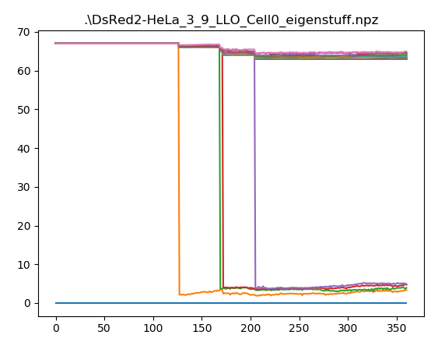
Model Limitations and Next Steps
Next steps in analysis
Laplacian Gradients
Clustering Eigenvalue changes
Look into Connectivity, cliques, and other classic graph metrics
Model limitations and future improvements
Incorporate a uniform component to account for background noise
Combat node collapse in LLO data
Incorporate dynamic node quantity
Fully automated segmentation
Notes:
Next steps in Analysis
View the change in Laplacian overtime for insights into local behaviors
Clustering Eigenvalue changes as time series data
Induce sparcity to allow views at classic graph metrics like connectivity, clustering coefficients etc.
Model limitations and improvements
Uniform component
Deal with Node collapse
Dynamic Node Quantity
Fully automated segmentation
The next steps in analysis are to move forward with observing the change in the series of Laplacians derived from each video possibly as a function of Laplacian gradients. This would highlight specific portions of the social networks that covary over space and time; in other words, it would provide insight into the coordinated fragmentation or hyper fusion of the mitochondria in response to the provided stimulus
These features could then be incorporated into a broader supervised learning pipeline to distinguish patterns and discern the effects of an unknown stimulant (e.g., drug discovery), or an unsupervised learning pipeline to identify all observed mitochondrial phenotypes.
Additional methods of analyzing the graph structure of the social network would help to determine specific phenotypic changes induced by certain stimuli. Classic graph metrics such as connectivity, cliques, and eigenvector centrality would help to precisely measure the global effects of certain stimuli on the mitochondria.
Further improvements can also be made to the network generation pipeline itself. We began working to incorporate a single uniform component into the overall GMM to provide a robust method of accounting for background noise in the form of a learned, data-driven threshold. A further shortcoming of the current GMM approach is a node collapse in some LLO samples. When the protein pattern fragments to a high enough extent some nodes will collapse because of a lack of probability mass in the area near the node
In our analysis steps we remove collapsed nodes from the network which causes a loss of the data accounted for by these nodes before their collapse. While these nodes were mostly small and accounted for small amounts of the overall protein structure, any data loss should be avoided in the modeling process if it can be.
An alteration to the pipeline which could both fix this issue and improve the model’s capability to mimic the 36 protein mass, is a flexible number of components. A large amount of information in temporal social network analysis comes from the addition and removal of nodes as entities appear and leave the community. Currently our model doesn’t allow for the addition of nodes to represent the splitting of mitochondrial communities or the removal of nodes to represent their merging. By adding this, a fragmentation period in LLO cells could be much more easily quantified by a change in the number of components as the communities dissipate.
Another shortcoming of our pipeline is the manual initialization. With deep learning models sitting at the cutting edge of semantic segmentation in biomedical images, the masks created in this study for the thousands of frames microscopy images can serve as a new training dataset for work in fully autonomous segmentation of mitochondrial protein structures. This would allow this pipeline to be more quickly and flexibly applied to larger sets of data while also allowing an expansion in the area of deep models for autonomous semantic segmentation

Slide 33
Conclusion
We have presented a pipeline for producing quantitative models of diffuse subcellular protein structure
We have shown how this model can evolve overtime to account for changing morphologies
We have shown how the properties of the network can be interpreted to provide biological insights
Notes:
- While there’s a lot of area to move forward on the ornet project
In my time on the projects we’ve
Presented a pipeline for producing quantitative models of mitochondria
Shown how the model can evolve overtime to follow dynamic morphologies
Shown how the parameters of the network can provide biological insight
In this paper, we have presented a proof-of-concept for parameterizing and modeling spatiotemporal changes in diffuse subcellular protein patterns using GMMs.
We have presented how the learned parameters of the GMM can be updated to account for changing biological phenotypes, and how these parameters can then be used to induce a social network of interacting nodes.
Finally, we show how the underlying properties of the social network can be interpreted to provide biological insights, particularly how the underlying system may be responding to some kind of stimulus.

Slide 34
Acknowledgements
Acknowledgements
This project was supported in part by a grant from the National Science Foundation (#1458766)
I would like to thank Mojtaba Fazli and Shannon Quinn for their help and guidance on this project
I would also like to thank Allyson Loy, Barbara Reaves, Abigail Courtney, Chakra Chennubhotla, Fred Quinn, Brittany Dorsey, and Chinasa Okolo. Their work with the Ornet project has made my research possible

Slide 35
References
Ljosa V, & Carpenter A E (2009). Introduction to the quantitative analysis of twodimensional fluorescence microscopy images for cell-based screening. PLoS computational biology, 5(12), e1000603.
Maška M, Ulman V, […], Ortiz-de-Solorzano C. (2014) A benchmark for comparison of cell tracking algorithms, Bioinformatics, Volume 30, Issue 11, 1 June 2014, Pages 1609–1617, https://doi.org/10.1093/bioinformatics/btu080
Ulman V, Maška M, […] Ortiz-de-Solorzano C. (2017) An objective comparison of cell-tracking algorithms. Nature Methods 14, 1141-1152
Chan F H Y, Lam F K, Zhu H. (1998). Adaptive Thresholding by Variational Method. IEEE Transactions on Image Processing, v. 7 n. 3, p. 468- 473
Kass M, Witkin A, Terzopoulos D. (1988) Snakes: Active Contour Models. International Journal of Computer Vision, 1 (4): 321. doi:10.1007/BF00133570.
Milgram S (1967). The Small-World Problem. Psychology Today vol 1, no 1, 61-67

